Slide 1
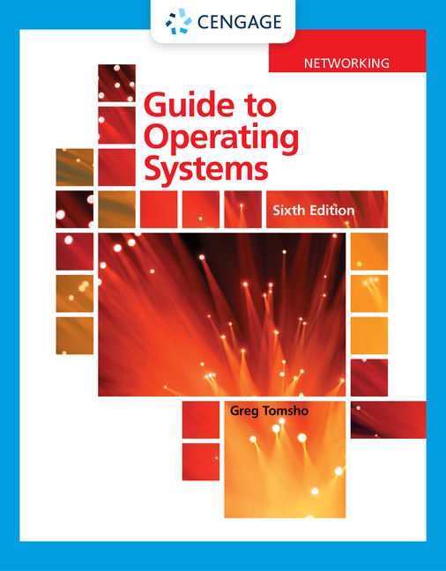
Guide to Operating Systems, 6th Edition
Module 11: Securing and Maintaining an Operating System
©2021 Cengage Learning. All Rights Reserved. May not be scanned, copied or duplicated, or posted to a publicly accessible website, in whole or in part.
Notes:
Add slide notes here

Slide 2
Learning Objectives
By the end of this module, you should be able to:
Devise a security policy for your client and server computers
Secure access to data on a computer
Maintain an operating system
Devise a backup plan
Notes:
Add slide notes here

Slide 3
Devising an Operating System Security Policy
A security policy is a document that describes the rules governing access to an organization’s information resources, enforcement of these rules, and steps taken if rules are breached
A security policy should:
Be easy for ordinary users to understand and reasonably comply with
Be enforceable
Clearly state the objective of each policy so that everyone understands its purpose

Slide 4
Determining Elements of an Operating System Security Policy
Basic items needed in order to start writing your security policy:
Privacy policy
Acceptable use policy
Authentication policy
Internet use policy
Access policy
Auditing policy
Data protection

Slide 5
How Much Security Do You Need? (1 of 2)
Before determining the level of security your OS needs, answer these questions:
What must be protected?
From whom should data be protected?
What costs are associated with security being breached and data being lost or stolen?
How likely is it that a threat will actually occur?
What’s the likelihood of a natural disaster?
Are the costs to implement security and train personnel to use a secure network outweighed by the need to create an efficient, user-friendly environment?

Slide 6
How Much Security Do You Need? (2 of 2)
A common guideline regarding network security:
“If there’s physical access to the computer, there’s no security”
No matter how strong your logon name and password schemes are, if a person has physical access to a device, access to data isn’t far behind
Your policies and practices should include how physical access to the computers is secured
Policies should specify that sensitive or valuable data should only be stored on company servers

Slide 7
Securing Access to Data on a Computer
Securing data on a computer has many facets:
Authentication and authorization
Encryption
Malware protection

Slide 8
Authentication and Authorization (1 of 12)
Authentication and authorization are security features that enable administrators to control who has access to the network (authentication) and what users can do after they are logged on to the network (authorization)
Authentication protocols used by OSs and network devices offer varying levels of secure authentication:
Kerberos – used in a Windows domain environment and provides mutual authentication
Remote Authentication Dial-In User Service (RADIUS) – an industry-standard client/server protocol that offers centralized control

Slide 9
Authentication and Authorization (2 of 12)
Authentication protocols used by OSs and network devices offer varying levels of secure authentication (continued):
Extensible Authentication Protocol (EAP) – a framework for other protocols that provide encryption and authentication
Microsoft Challenge Handshake Authentication Protocol version 2 (MS-CHAP v2) – a mutual authentication protocol
Microsoft Challenge Handshake Authentication Protocol (MS-CHAP) – an earlier version
Password Authentication Protocol (PAP)

Slide 10
Authentication and Authorization (3 of 12)
Multifactor Authentication
Multifactor Authentication (MFA) requires a user to supply two or more types of authentication drawn from these credential categories:
Knowledge – what the user knows (username/password)
Possession – what the user has (smart card or key)
Inherence – what the user is; a unique biometric identifying trait (fingerprint, retina scan, or voice pattern)

Slide 11
Authentication and Authorization (4 of 12)
Configuring Password Requirements in a Windows Environment
Network OSs include tools that enable administrators to specify options and restrictions on how and when users can log on to the network
Windows OSs allow passwords of up to 128 characters
A minimum of five to eight characters is typical

Slide 12
Authentication and Authorization (5 of 12)
Configuring Password Requirements in a Windows Environment (continued)
Other password options include:
Maximum password age
Minimum password age
Enforce password history – Determines how many different passwords must be used before a password can be used again
Password policies for a single Windows computer can be set in the Local Security Policy console found in Administrative Tools

Slide 13
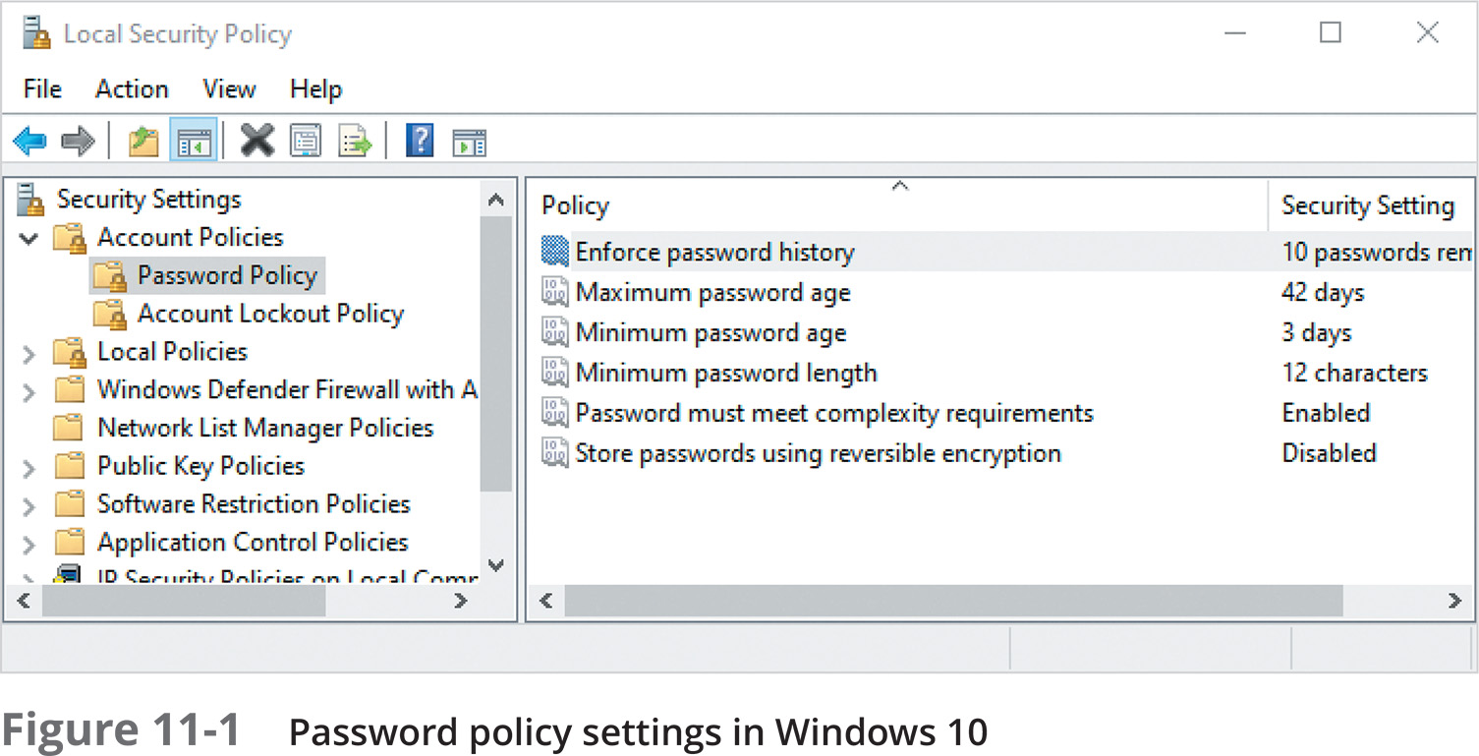
Authentication and Authorization (6 of 12)

Slide 14
Authentication and Authorization (7 of 12)
Configuring Password Requirements in a Linux Environment
You must edit a configuration file to change password options in Fedora Linux
Fedora 30 has some default settings to ensure a minimally secure password:
Passwords must be at least eight characters
Passwords must not contain common dictionary words or patterns
Passwords must not contain any form of the user logon name

Slide 15
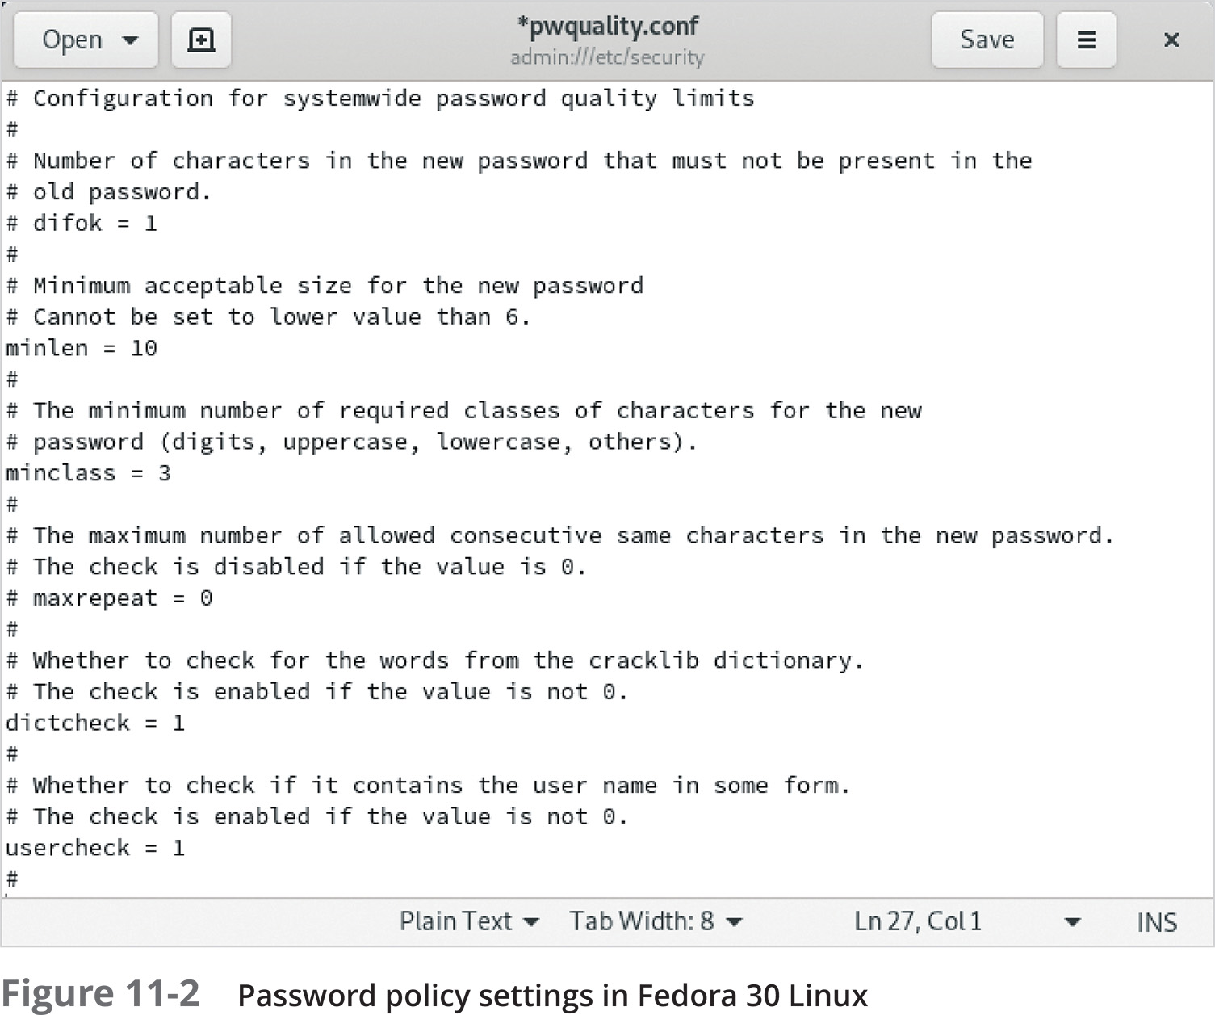
Authentication and Authorization (8 of 12)
In Fedora Linux, password complexity settings can be found in /etc/security/pwquality.conf
Figure 11-2 shows a number of options that can be used to ensure users create more secure passwords

Slide 16
Authentication and Authorization (9 of 12)
Password expiration settings can be configured by editing the following lines in the /etc/login.defs file:
PASS_MAX_DAYS 99999
PASS_MIN_DAYS 0
PASS_WARN_AGE 7

Slide 17
Authentication and Authorization (10 of 12)
Password Dos and Don’ts
Use a combination of uppercase letters, lowercase letters, numbers, and special characters
Consider using a phrase, such as I L!ke computer $ecurity
Don’t use passwords based on your logon name, your family members’ names, or pets’ names
Don’t use common dictionary words unless they are part of a phrase
Don’t make your password so complex that you forget it
Consider a password manager app

Slide 18
Authentication and Authorization (11 of 12)
Restricting Logon Hours and Logon Location
Most OSs have a way to restrict logon times by time of day, day of week, and location
In Windows, the default settings allow logon 24 hours a day, seven days a week
A common use of restricted logon hours is to disallow logon during a system backup
Users can be restricted to logging on only from particular workstations

Slide 19
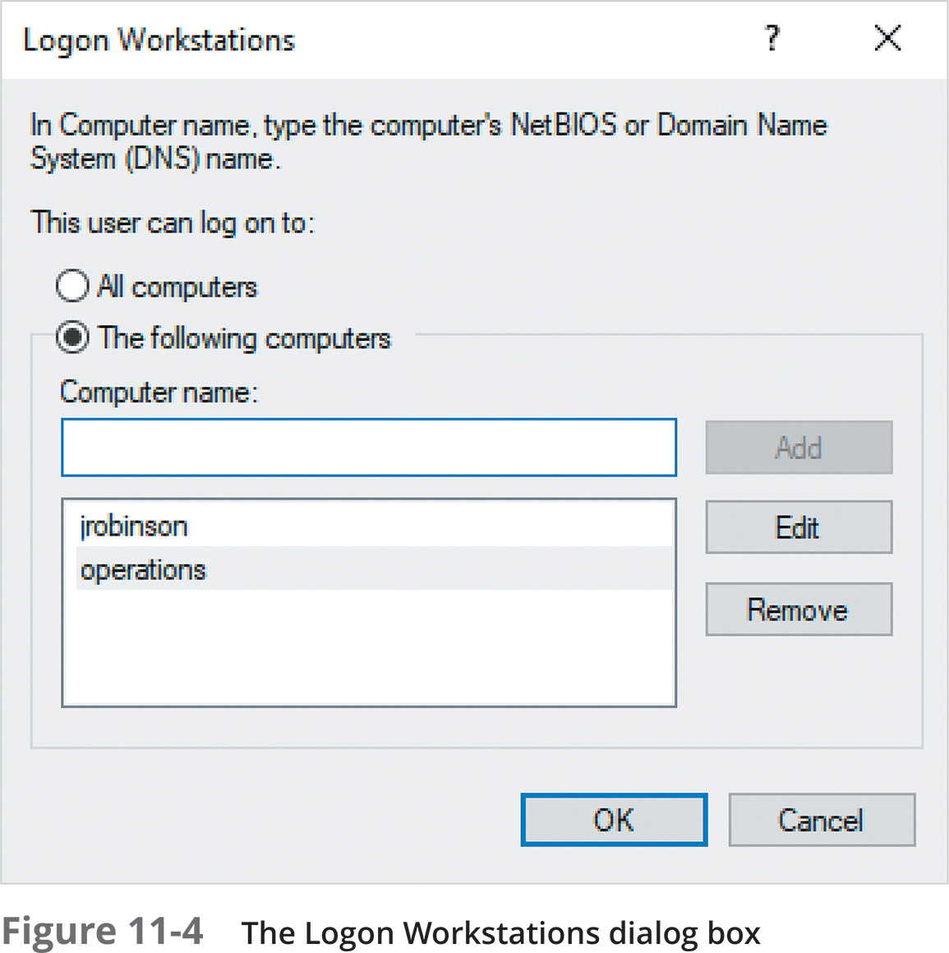
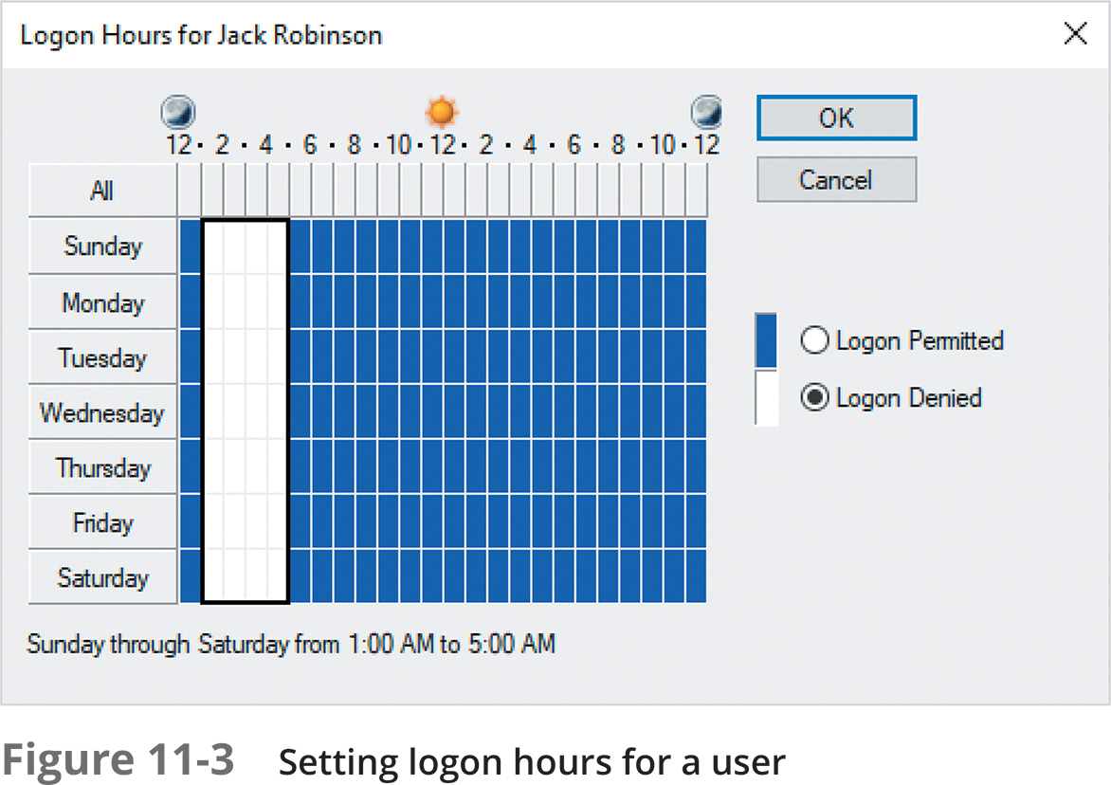
Authentication and Authorization (12 of 12)

Slide 20
Data Encryption (1 of 3)
Encryption prevents people from using eavesdropping technology, such as a protocol analyzer (packet sniffer), to capture packets
Data can also be secured with encryption to prevent someone who has gained physical access to a computer from being able to use the data
The most widely used method for encrypting data is IP Security (IPsec)
An association is formed by two devices authenticating their identities via a preshared key, Kerberos authentication, or digital certificates

Slide 21
Data Encryption (2 of 3)
A preshared key is a series of letters, numbers, and special characters that two devices use to authenticate each other’s identity (an administrator enters the same key in the IPsec settings on both devices)
Kerberos authentication also uses keys, but the OS generates the keys
Digital certificates involve a certification authority (CA)
Someone who wants to send encrypted data must apply for a digital certificate from a CA, which is responsible for verifying the applicant’s authenticity
Public CAs, such as GlobalSign, sell certificates to companies that want to have secure communication sessions across public networks

Slide 22
Data Encryption (3 of 3)
If someone gains access to the hard disk where data is stored, your data could be vulnerable
In Windows OSs, Encrypting File System (EFS) is used to encrypt files and folders
EFS works in one of three modes: transparent mode, USB key mode, and user authentication mode
BitLocker is a good security enhancement for servers that aren’t physically secure and for mobile devices at risk of being lost or stolen

Slide 23

Knowledge Check 1
Which element of a security policy describes how users identify themselves to gain access to network resources?
A) privacy policy
B) access policy
C) acceptable use policy
D) authentication policy

Slide 24

Knowledge Check 1: Answer
Which element of a security policy describes how users identify themselves to gain access to network resources?
D) authentication policy

Slide 25
Securing a Computer with a Host Firewall (1 of 2)
A firewall creates a barrier between two entities
A network firewall creates a barrier between networks so that potentially harmful packets can’t enter or leave the protected networks
A host firewall creates a barrier between a computer OS and the network so potentially harmful packets can’t enter or leave the OS
Most modern OSs come with a built-in host firewall that is preconfigured to disallow most incoming packets that have been requested

Slide 26
Securing a Computer with a Host Firewall (2 of 2)
A host firewall is a layer of software that operates between the NIC and OS services and applications
The firewall is composed of a set of rules that specify which network packets are allowed to be processed based on the network protocols and network addresses contained in the packets
Each incoming or outgoing packet is examined and compared against the list of rules to see if the packet should be dropped or sent

Slide 27
Working with Windows Defender Firewall (1 of 7)
Windows Defender Firewall is enabled and configured with default settings
There are three network categories:
Domain network
Private network
Guest or public network
If the computer detects that it is on a domain, the domain settings are automatically applied

Slide 28
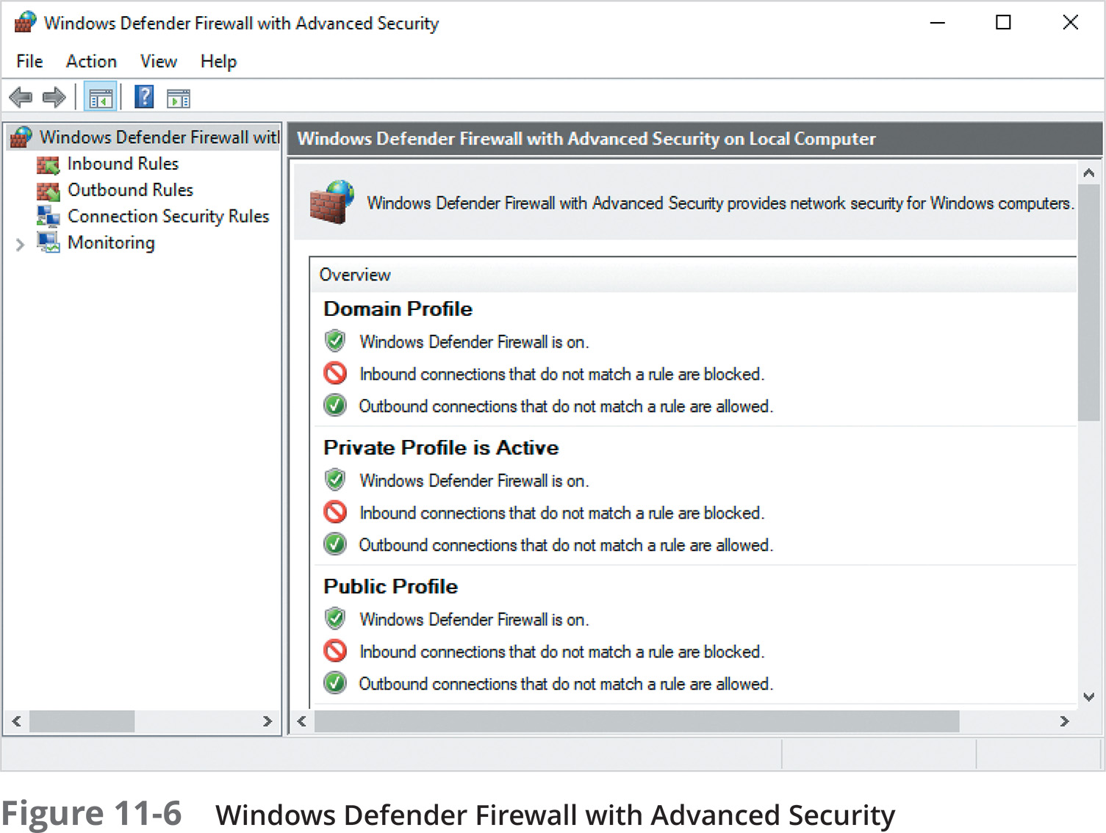
Working with Windows Defender Firewall (2 of 7)

Slide 29
Working with Windows Defender Firewall (3 of 7)
Configuring Windows Firewall
If a computer or server is not communicating with certain applications or services, the protocol might be blocked
The default setting for incoming packets is to block them unless a firewall rule specifically allows them
Installing or enabling certain Windows applications or services sometimes automatically sets the necessary firewall rules they require
Use the Windows Defender Firewall app to allow a particular application

Slide 30
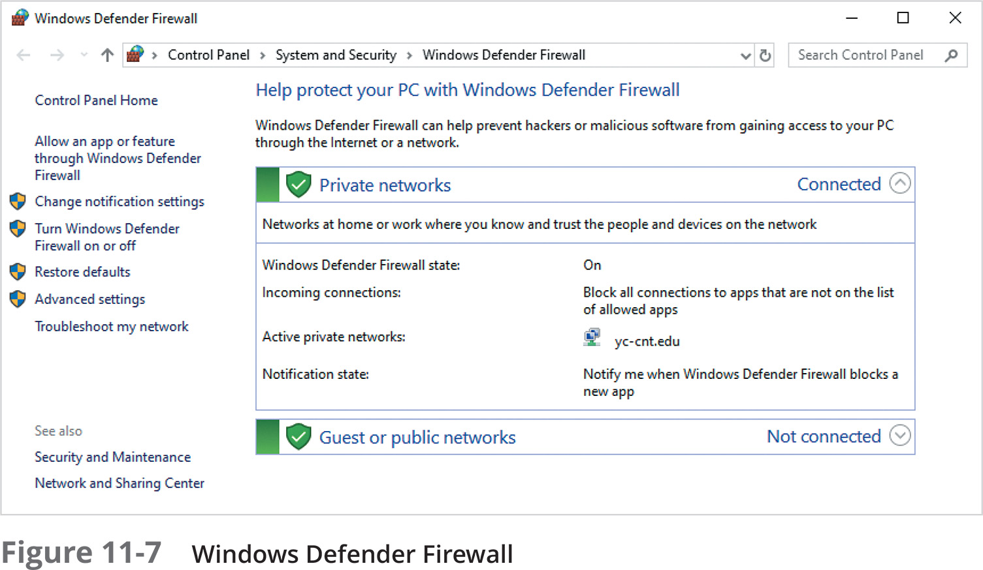
Working with Windows Defender Firewall (4 of 7)

Slide 31
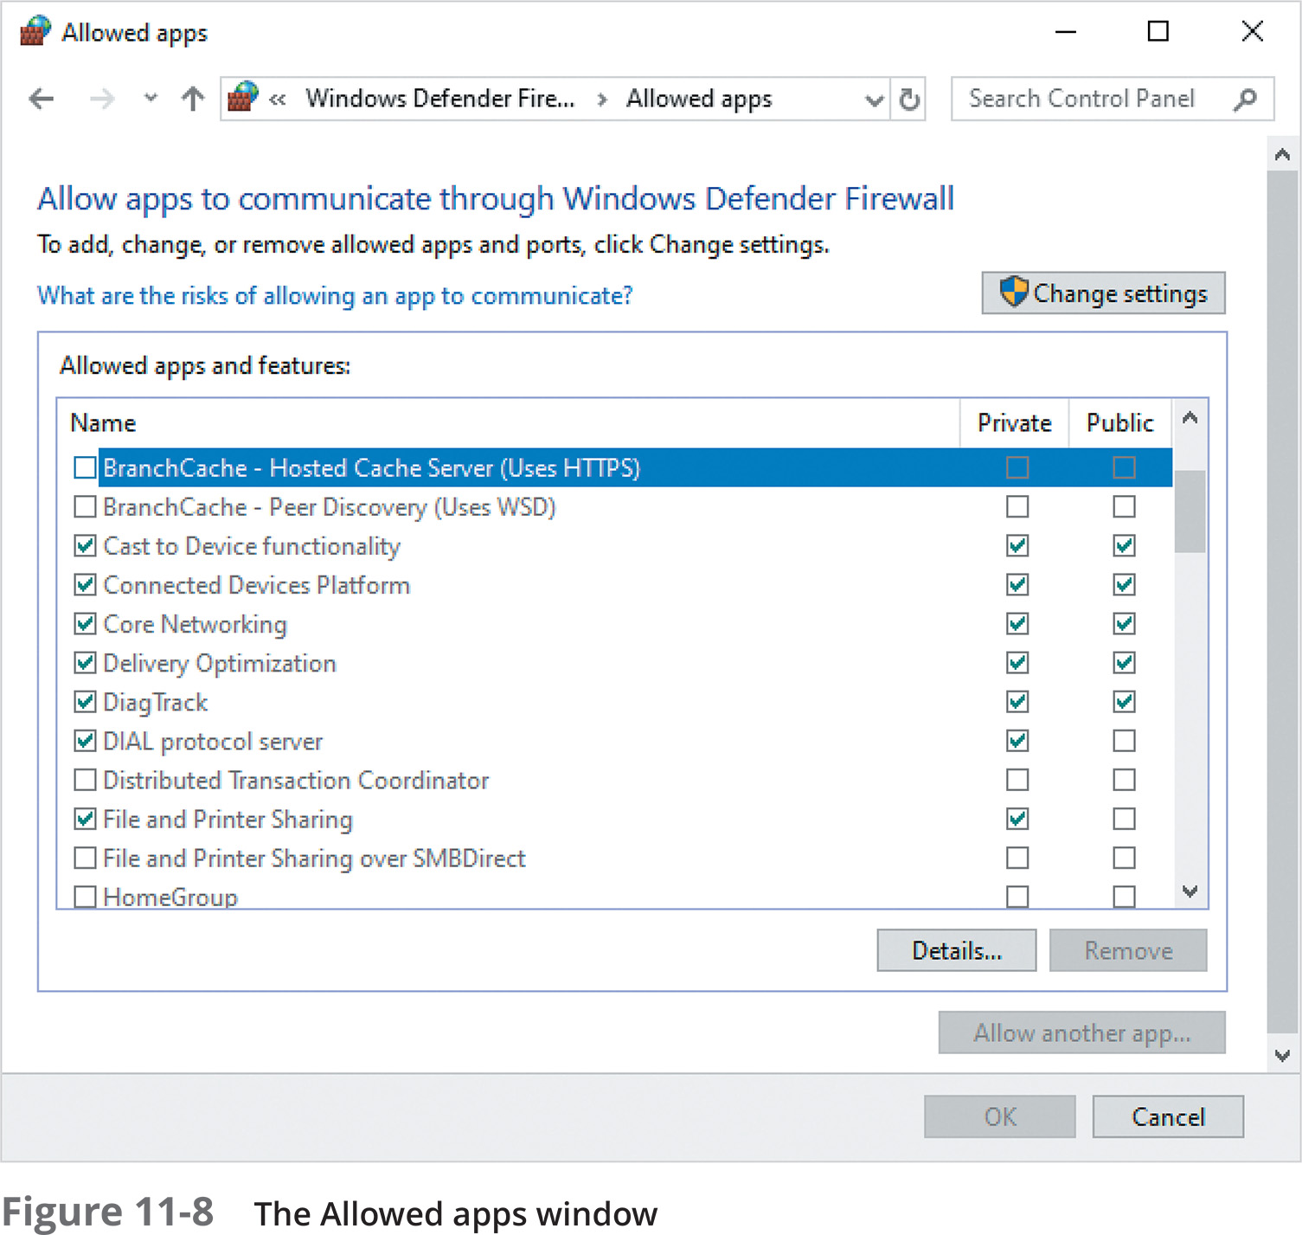
Working with Windows Defender Firewall (5 of 7)
To quickly see and change which apps and features are allowed, click “Allow an app or feature through Windows Defender Firewall”
This opens the Allowed apps window
If the application you want to allow is not listed, click “Allow another app” and browse for the application file

Slide 32
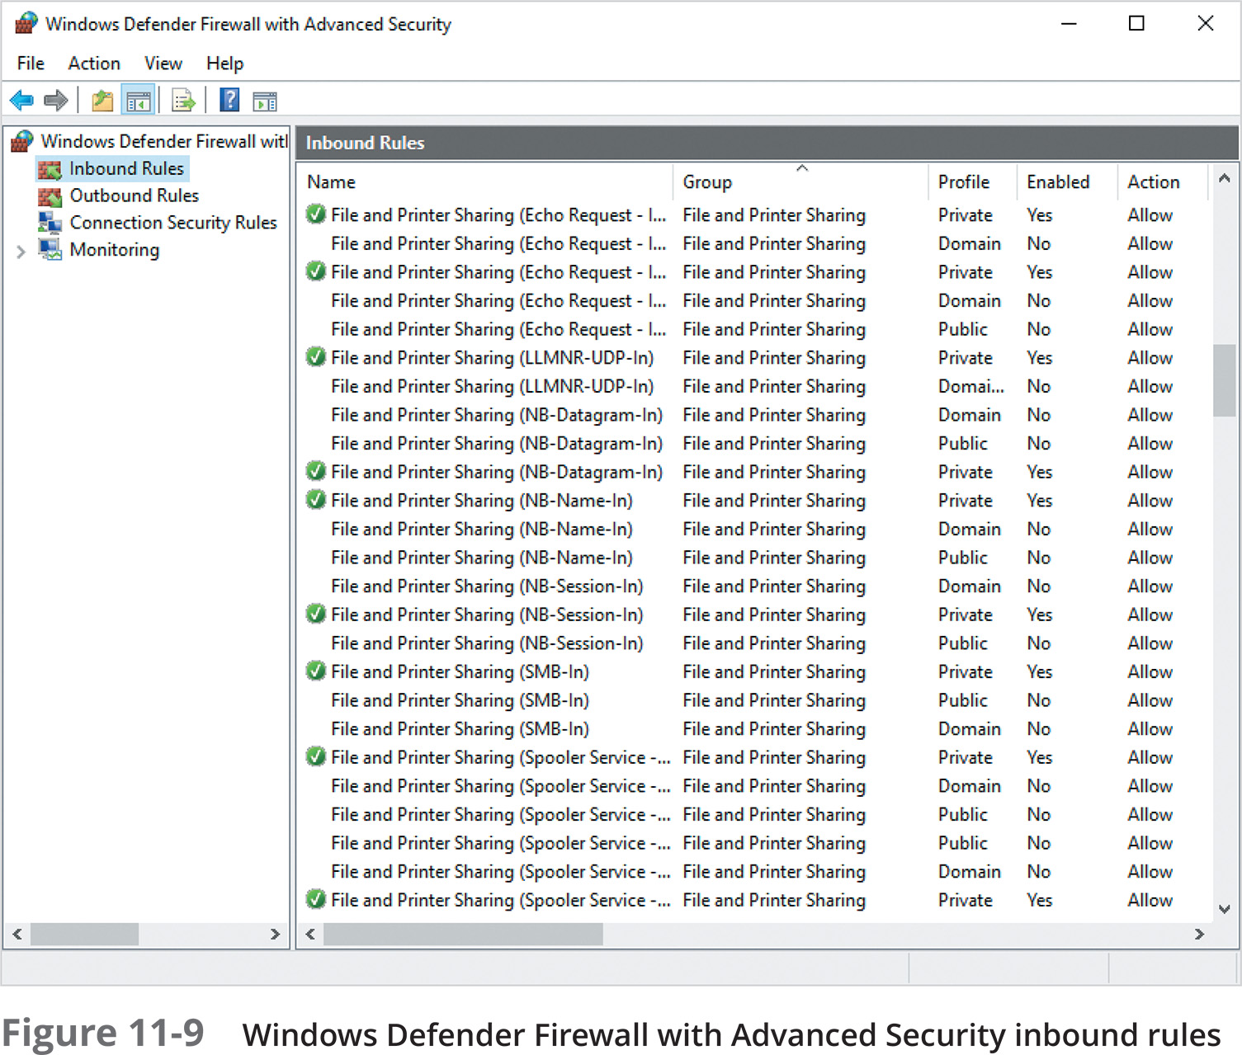
Working with Windows Defender Firewall (6 of 7)
Open the Windows Defender Firewall with Advanced Security app to see a detailed list of all predefined rules and create custom rules as well
Open this app by clicking Advanced settings in the Windows Defender Firewall app
Rules shown with a check mark in a green circle are enabled

Slide 33
Working with Windows Defender Firewall (7 of 7)
Custom rules can be created by right-clicking Inbound Rules (or Outbound Rules) and clicking New Rule
The New Rule Wizard guides you through the process of selecting the type of rule you want to create and the protocols or applications that the rule will apply to
If you make many changes and you want to revert to the default settings:
Right-click the Windows Defender with Advanced Security node in the left pane
You will see options to import, export, and restore defaults

Slide 34
Configuring the Firewall in Linux (1 of 2)
Most Linux distributions have a built-in firewall called netfilter
Initial firewall settings and tools used to configure and manage netfilter vary among the different distributions
A common tool used by many Linux administrators is iptables
It is a command-line program
To see the current firewall configuration, type iptables –L in a terminal window

Slide 35
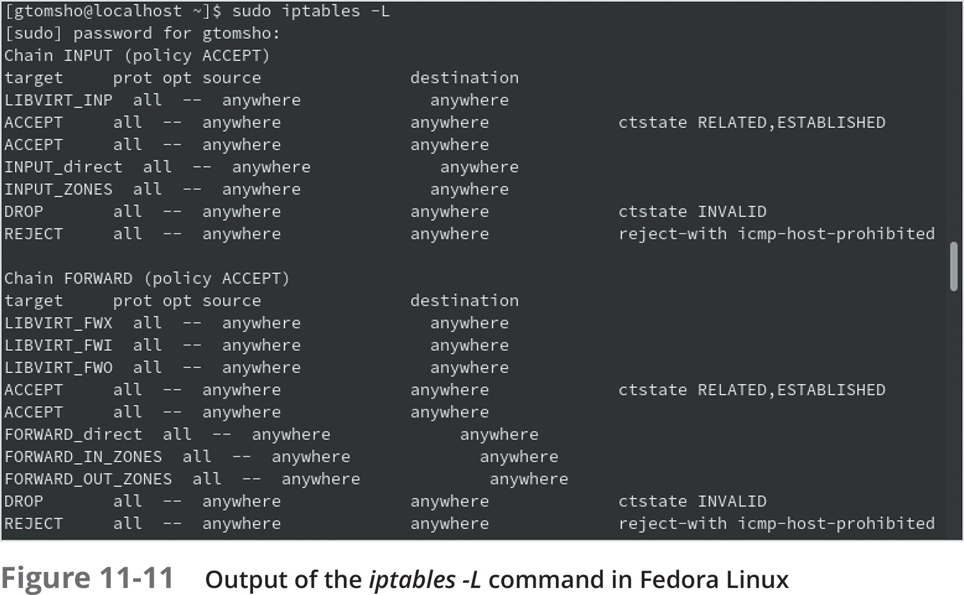
Configuring the Firewall in Linux (2 of 2)

Slide 36
Configuring the Firewall in macOS (1 of 2)
macOS has a built-in firewall that can be accessed through the Security & Privacy app in System Preferences
The firewall in macOS is off by default
The default settings, once turned on, allow all built-in software and downloaded signed software to receive incoming connections
If you enable a service like SMB file sharing, macOS will add a rule to allow that service (see Figure 11-13)

Slide 37
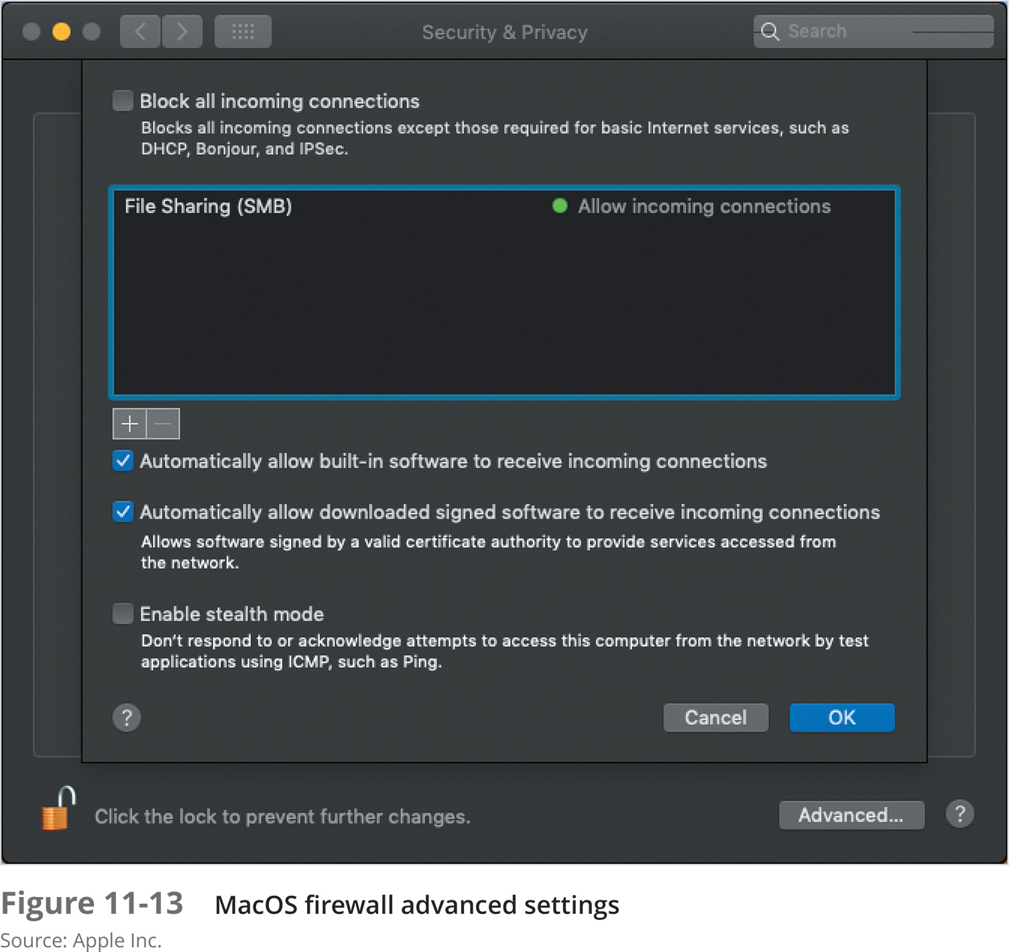
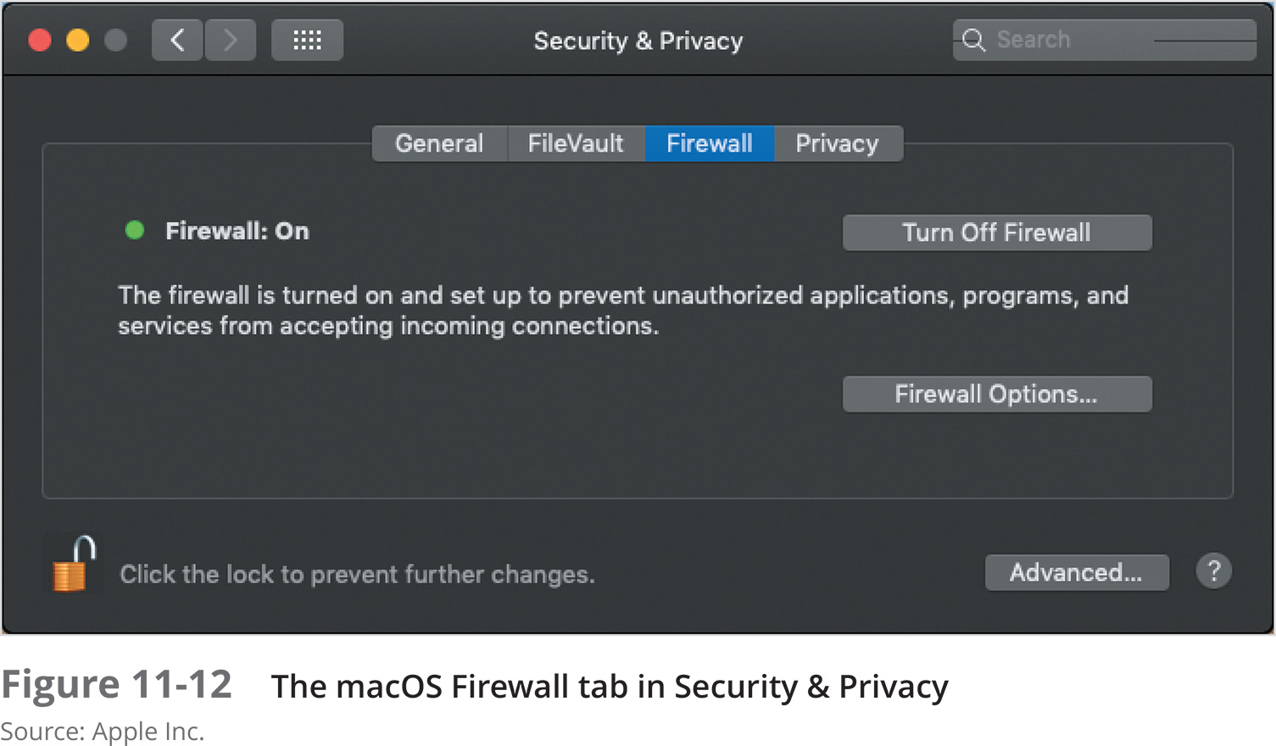
Configuring the Firewall in macOS (2 of 2)

Slide 38
Maintaining an Operating System
OSs require periodic maintenance and updates to maintain security, reliability, and performance levels
This section discusses OS updates, file system management, and memory optimization tips and techniques

Slide 39
Installing Operating System Updates and Patches (1 of 4)
One of the most important ways to keep your OS tuned is by installing system updates issued by the vendor
Some security flaws are discovered by the OS vendor or white hat testers who are paid to probe networks and report vulnerabilities
Others are discovered by black hat attackers who do not report problems, but instead disseminate the information to other black hat attackers
Because some updates are urgently needed, Windows computers are set to automatically download and install updates by default

Slide 40
Installing Operating System Updates and Patches (2 of 4)
Windows Server comes with an update management system called Windows Server Update Services (WSUS)
WSUS is a server role that makes it possible for administrators to take control of Microsoft product updates (a process called patch management)
Advantages of using WSUS:
Centralized control over Microsoft product updates
Reduced Internet bandwidth usage
Only approved updates are installed
Easy to determine which patches and updates have been applied

Slide 41
Installing Operating System Updates and Patches (3 of 4)
Managing Linux and macOS Updates
Linux and macOS have update components built into the OS
You probably will have to install third-party software to centrally manage updates
On Fedora Linux, you configure and install updates using the Software tool
When you open the System Preferences app in macOS, the app checks for updates and displays options for installing updates and managing updates

Slide 42
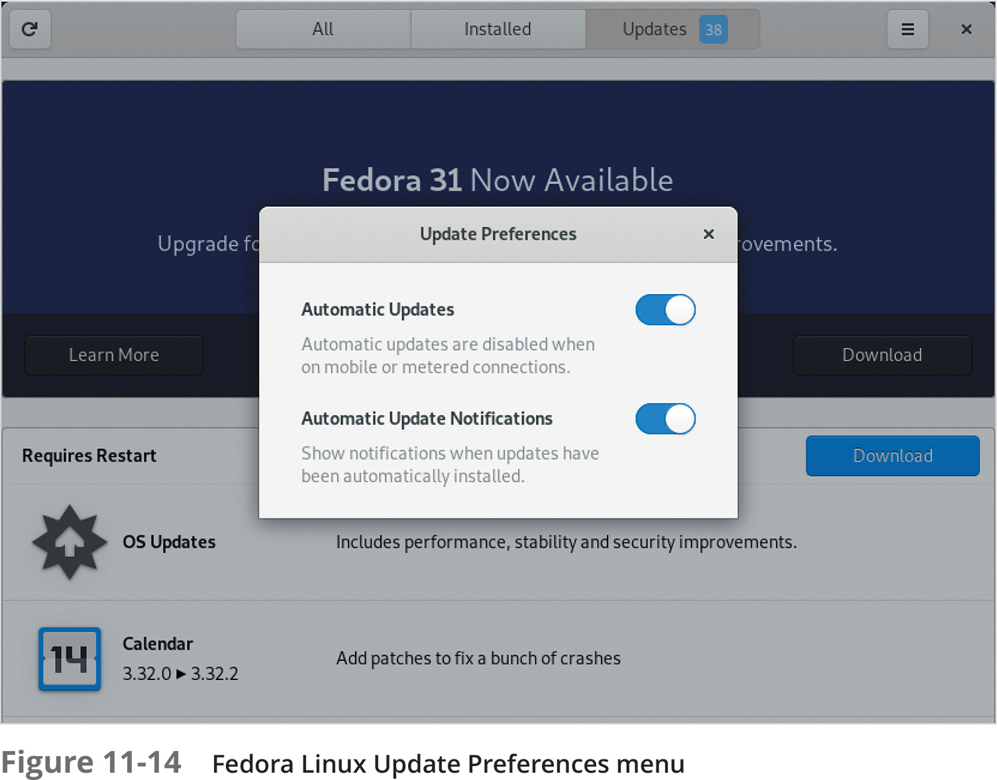
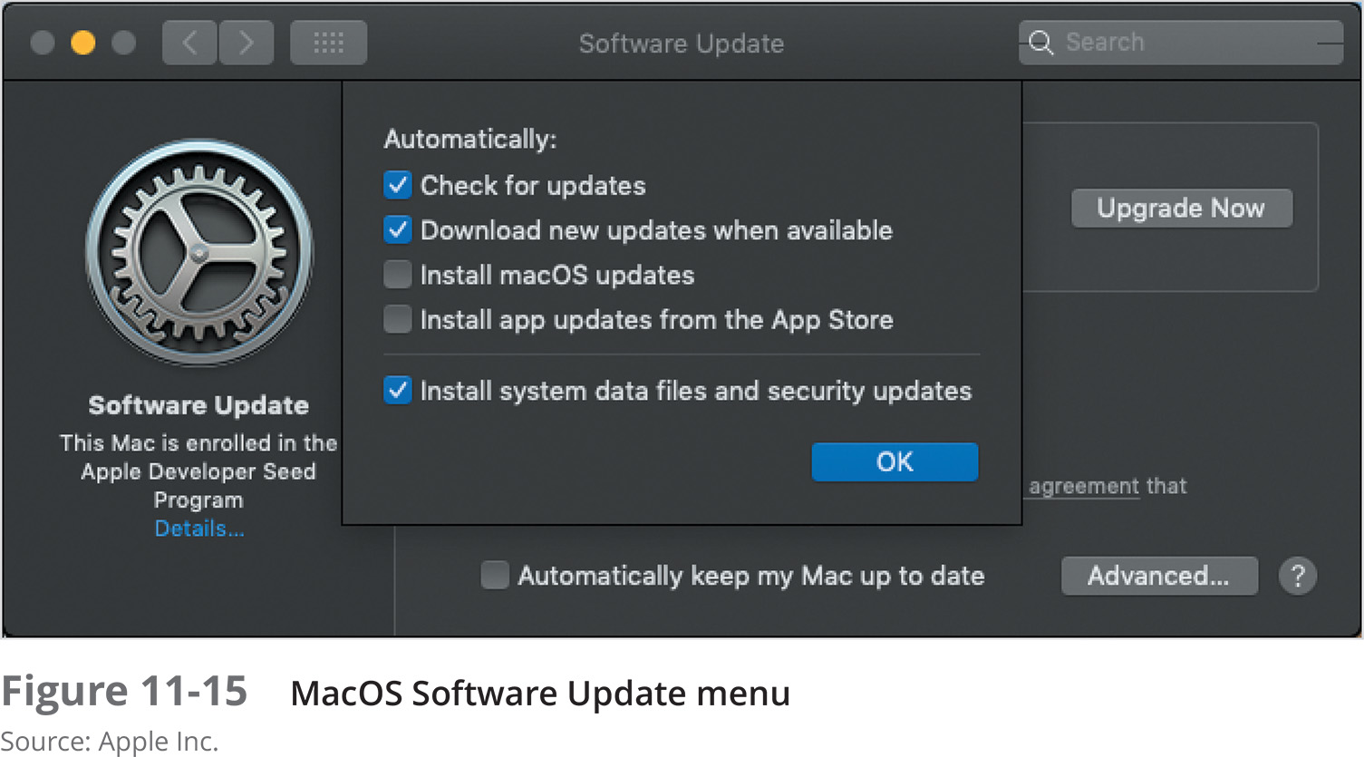
Installing Operating System Updates and Patches (4 of 4)

Slide 43
Maintaining the File System (1 of 5)
Files can quickly accumulate, occupy a large amount of disk space, and slow down access to files
Deleting files is vital for making the best use of disk storage resources and improving OS performance and reliability
Temporary files (typically located in the \Temp and \Windows\Temp folders) accumulate and should be deleted
Use the Disk Cleanup tool to delete unneeded files in Windows

Slide 44
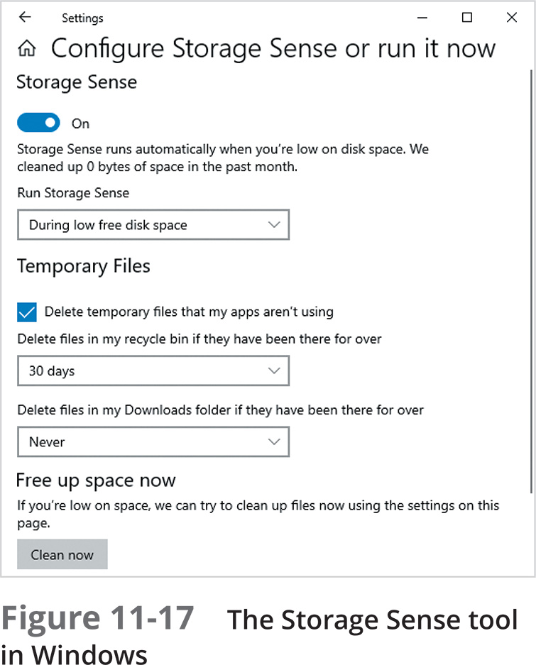
Maintaining the File System (2 of 5)
Windows 10 includes a utility called Storage Sense that, when enabled, runs automatically when disk space is low
It can be configured to delete temporary files, old Recycle Bin files, and files in the Downloads folder

Slide 45
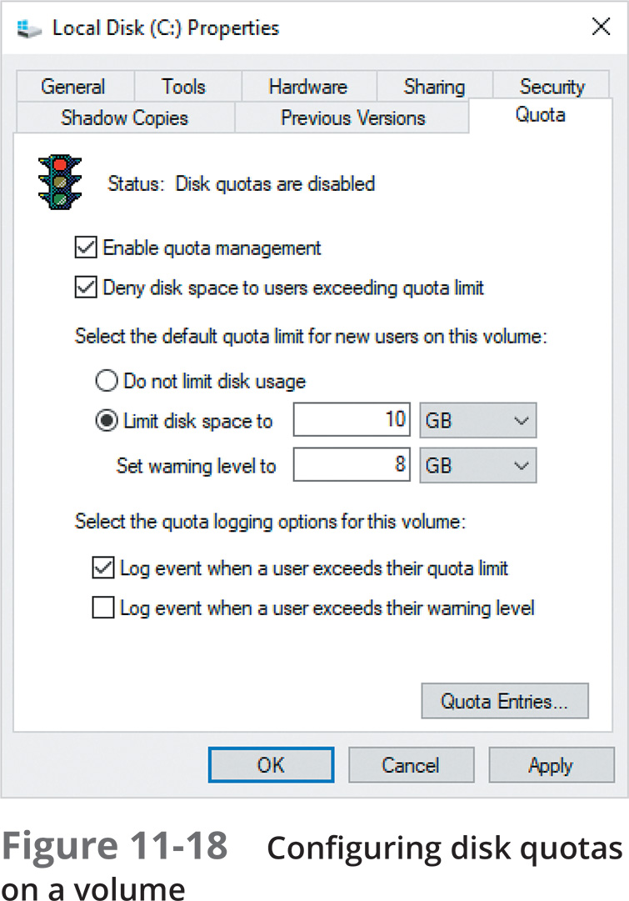
Maintaining the File System (3 of 5)
Disk quotas allow an administrator to specify the maximum amount of space any user’s files can occupy on a volume or in a share
In addition, you can install File Server Resource Manager on Windows Server and set policies that restrict the types of files that can be stored

Slide 46
Maintaining the File System (4 of 5)
View Linux files by using the ls command
Files and folders are deleted in Linux using the remove (rm) command
To delete files in the /home/mjackson/docs folder, enter:
rm /home/mjackson/docs/*.txt
The Linux GNOME Files tool offers a trash can for deleting files permanently
Purge files by clicking Trash in Files and clicking Empty

Slide 47
Maintaining the File System (5 of 5)
macOS automatically cleans out many temporary, log, and other files on a regular basis
In a Finder window, you can list files by date and size to quickly find old or large files that you no longer need
Because macOS is based on Linux, you can use most of the same command-line tools in macOS that you can in Linux

Slide 48
Managing Virtual Memory (1 of 2)
Virtual memory is disk storage used when there is not enough RAM for a particular operation or for all processes currently in use
Information that is swapped back and forth from RAM to disk and vice versa is stored in a specially allocated disk area called the page file, paging file, or swap file
Generally, the rule for sizing the page file is to set the initial size to 1.5 times the amount of RAM
In Windows 8, Windows Server 2012, and later versions, the paging file size is configured by default automatically

Slide 49
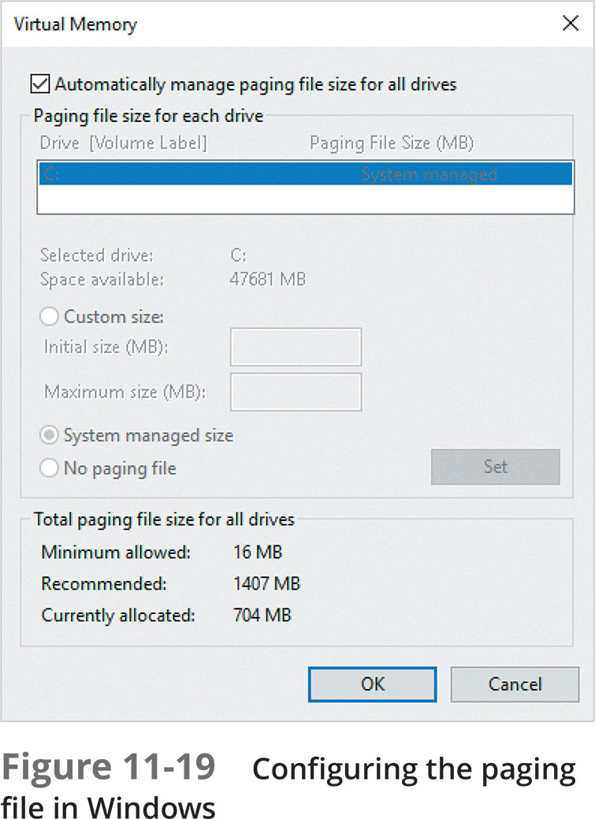
Managing Virtual Memory (2 of 2)

Slide 50
Making Backups (1 of 2)
Types of backups:
Image backup – backs up the disk sector by sector to create an exact image of the disk’s contents
Full file-by-file backup – all of the disk’s contents are backed up as individual folders and files
Differential backup – only backs up files that have changed since the last full backup
Incremental backup – backs up any files that have changed since the last full or incremental backup

Slide 51
Making Backups (2 of 2)
Consider the following regarding backups:
Determine what information needs to be backed up and how often
Use scheduling software
Choose the right backup media
Rotate backup media
Store a set of backups in an off-site location
Regularly use file repair tools and a virus checker
Investigate third-party backup software

Slide 52
Knowledge Check 2
Which of the following terms best describes a specially allocated disk area that holds information that is swapped back and forth from RAM to disk?
A) Recycle Bin
B) page file
C) disk quota
D) Disk Cleanup

Slide 53
Knowledge Check 2: Answer
Which of the following terms best describes a specially allocated disk area that holds information that is swapped back and forth from RAM to disk?
B) page file

Slide 54

Summary (1 of 2)
A security policy should reflect an organization’s attitude toward securing valuable resources
Be aware that costs are associated with implementing security practices
Modern OSs are designed to store and share data and make that data accessible
Securing data on an OS involves authentication, authorization, encryption, and malware protection
A firewall creates a barrier between two entities

Slide 55
Summary (2 of 2)
OSs require periodic maintenance and updates to maintain security, reliability, and performance levels
One of the most important ways to keep your OS tuned is by installing system updates issued by the vendor
An important practice for maintaining an OS is to regularly find and delete unused files
Most OSs supplement RAM by employing virtual memory techniques
An important part of maintaining a system is to make regular backups

